Slide 1




House Price Prediction
Accurate house price prediction is crucial for homebuyers, sellers, and investors in the real estate market. This presentation will explore the key factors influencing home prices and demonstrate a comprehensive approach to forecasting property values.
by KUNAL RAJ

Slide 2

Introduction to Housing Market
Demand Factors
Supply Factors
Market Dynamics
Population growth, job opportunities, and interest rates impact housing demand.
New construction, inventory levels, and zoning regulations influence housing supply.
The balance of supply and demand determines home prices in local markets.

Slide 3
Factors Influencing Home Prices
1
Location
2
Property Characteristics
Proximity to amenities, school districts, and transportation hubs.
Square footage, number of bedrooms/bathrooms, lot size, age, and condition.
3
Neighborhood Features
4
Economic Conditions
Crime rates, community facilities, and average household income.
Mortgage rates, unemployment levels, and consumer confidence.

Slide 4
Data Collection and Preprocessing
Data Sources
Data Cleaning
Multiple Listing Service (MLS), Census Bureau, and real estate transaction records.
Handling missing values, removing outliers, and standardizing data formats.
Feature Engineering
Data Split
Deriving new predictive variables from the raw data.
Dividing the dataset into training, validation, and test sets.

Slide 5
Exploratory Data Analysis
Descriptive Statistics
Correlations
Visualizations
Identifying the relationships between home prices and predictor variables.
Creating scatter plots, histograms, and other charts to uncover insights.
Analyzing the mean, median, standard deviation, and other key metrics.

Slide 6
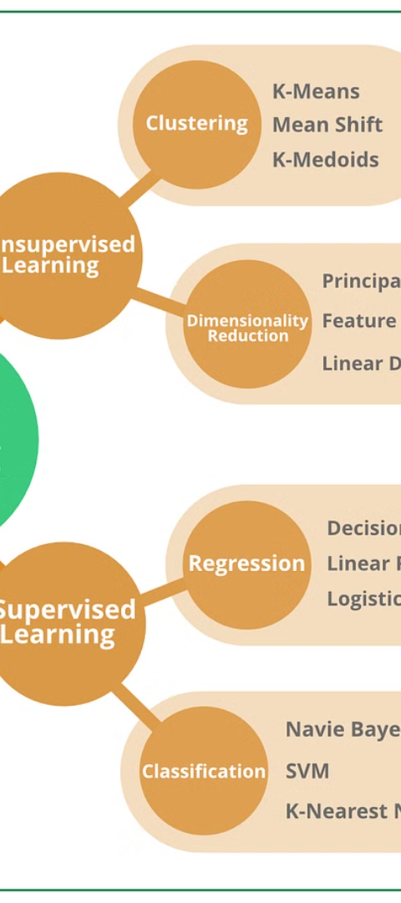



Model Selection and Training
Linear Regression
Modeling the linear relationship between predictors and home prices.
Decision Trees
Capturing non-linear patterns and complex interactions in the data.
Random Forests
Combining multiple decision trees to improve accuracy and robustness.

Slide 7




Model Evaluation and Validation
Accuracy
R-squared
Cross-Validation
Feature Importance
Measuring the model's ability to predict home prices with low error.
Assessing the proportion of variance in home prices explained by the model.
Ensuring the model's performance generalizes to new, unseen data.
Identifying the key drivers of home prices to inform business decisions.

Slide 8

Conclusion and Future Considerations
1
Key Insights
Summarize the main findings and their implications for real estate stakeholders.
2
Limitations and Challenges
Acknowledge the limitations of the current approach and potential areas for improvement.
3
Future Opportunities
Explore how advancements in data and AI could enhance house price prediction models.

